Slide 1
Progress Report
Thanawat Tejapijaya

Slide 2
Content
Network Traffic
Network Packet
Dataset

Slide 3
Currently writing Research Proposal, this report will focus only dataset explanation

Slide 4
Network Traffic
Amount of data moving across computer through network or internet at any given time
Before data is sent it will be break down into small pieces called data packet
These data packets will be sent separately through the best route of the network to get the most efficiency way to go to the destination

Slide 5
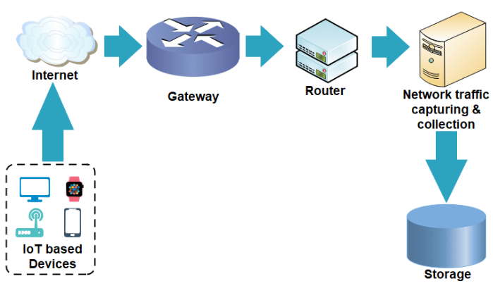

Network Traffic
Picture thanks to Empirical Characterization of Network Traffic for Reliable Communication in IoT Devices - Scientific Figure on ResearchGate. Available from: https://www.researchgate.net/figure/The-network-traffic-flow-capturing-and-collection-mechanism-for-IoT-based-devices_fig2_349839218 [accessed 23 Jun, 2023]
*Arrow represent the flow of Network Packets

Slide 6
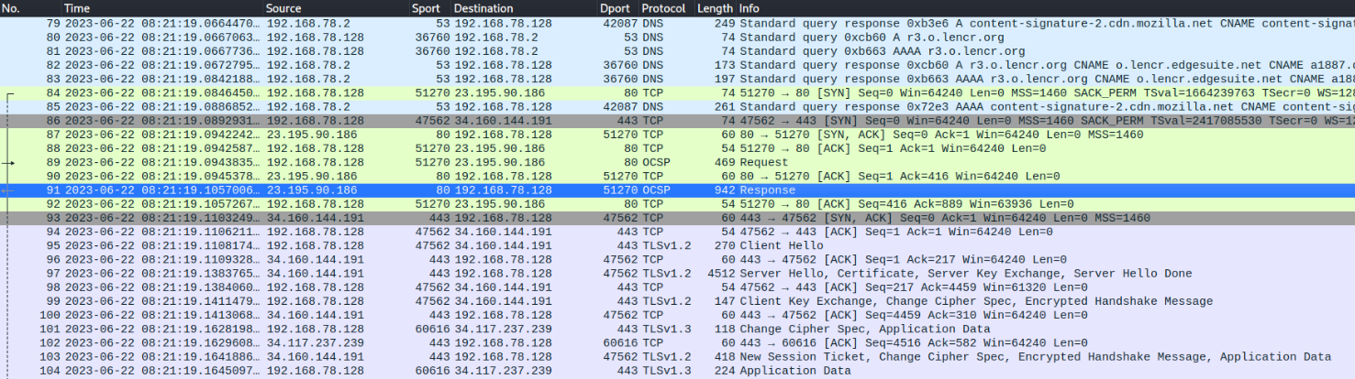
Network Packet
*IP Address is a numerical label that will identify each device on the internet
**Port is a number that identify a connection endpoint different port will have different type of service like a door
Internet Protocol: A set of rule on how data should be delivered over the internet
Number of Packet
Source IP Address*
Source Port**
Additional Information of the packet
Packet Arrival Time
Destination Port**
Destination IP Address*
Size of the Packet (measure in Bytes)

Slide 7
Definition
Abnormal Flows mean Every Botnet Attack Flows
Normal Flows mean Every Flows that isn’t botnet

Slide 8
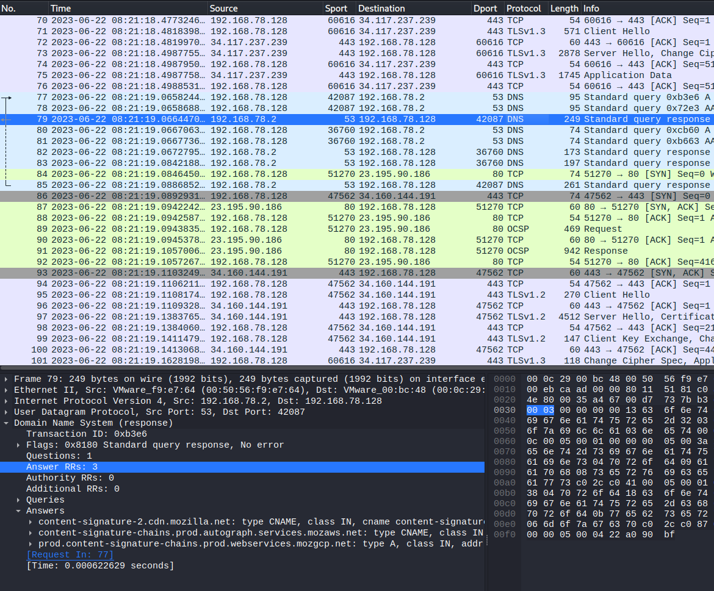
Normal Network Packet
Normally, it won’t be high (normally max is 512 bytes for DNS protocol)
Normally, will be less than 5, this is 3 which is normal

Slide 9
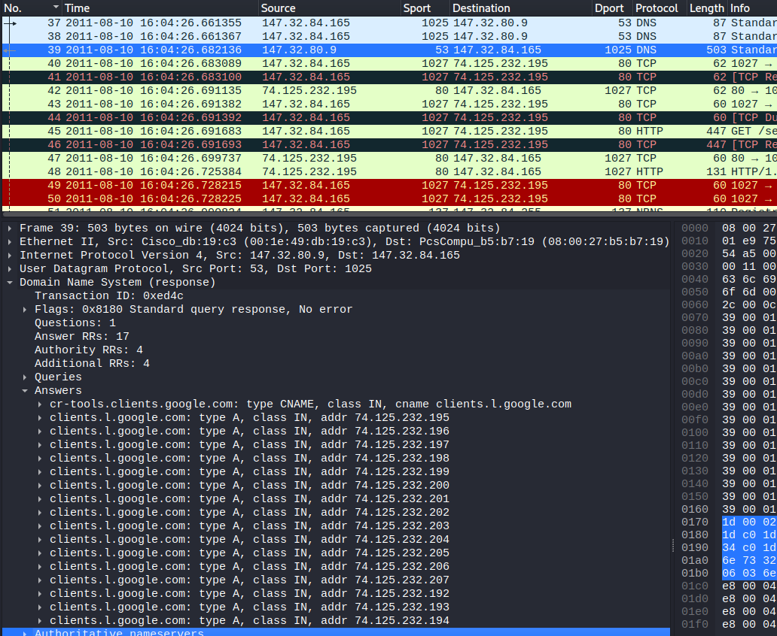
Generally, from Network Packet Which one is Botnet?
Normally max Bytes is 512 Bytes, but this is 503 Bytes, Almost reach the limit!
Coming in same sequence
Dangerous Port, use to send password*
Normally, this will be less than 5 but This is 17!
Searching For victim machine to spread the botnet

Slide 10
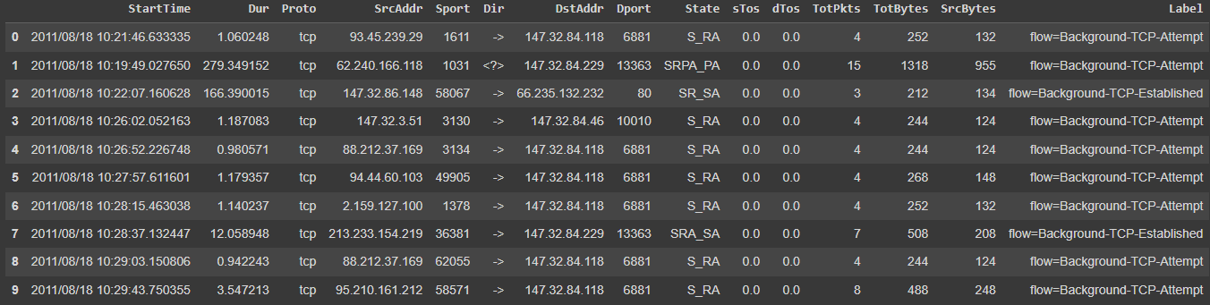
Dataset
Contain 13 files each files is independent from each others due to different behaviors of Botnet
15 Features
7 Categorical Features
7 Numerical Features
1 label

Slide 11

Normal – Everything that is not botnet

Slide 12
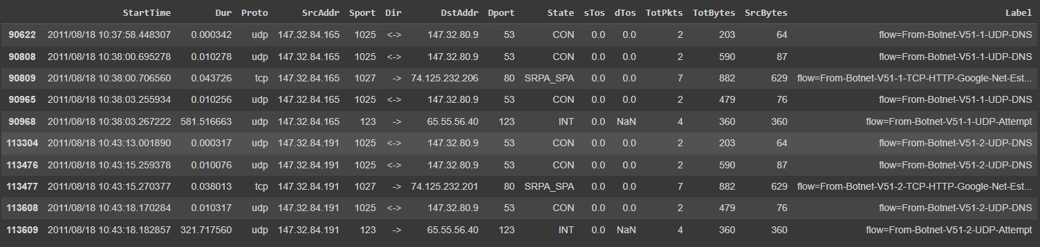
Abnormal – Every Botnet Attack
Using Dangerous sport to access destination through public Port
Mostly, total Bytes transfer is a lot in short amount of time
Duration of the connection is either very long or very short
Send the same sequence from same source to same destination
From same Source address access with same destination address in short amount of time

Slide 13
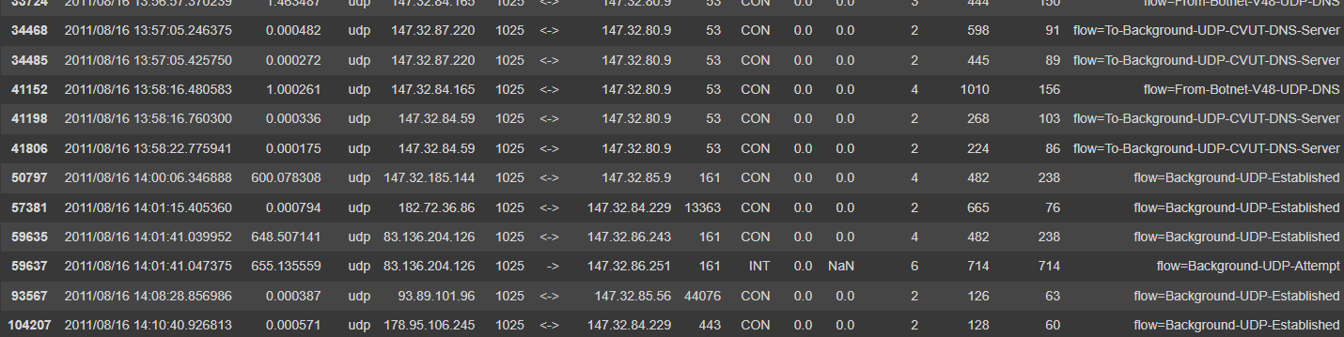
Abnormal – False Positive (Not botnet but get detect as botnet)
total Bytes transfer is a lot in short amount of time
Using Dangerous sport to access destination through public Port
Duration
From same Source address access with same destination address in short amount of time
Almost has the same characteristic as botnet

Slide 14
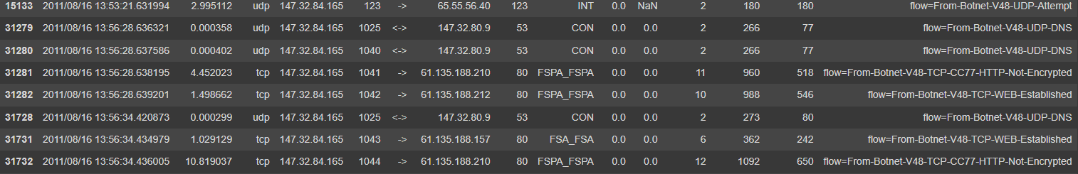
False Negative (Botnet but get detect as normal)
Using normal sport to access destination through public Port
Duration
From same Source address access but different destination address

Slide 15
Future Work
Continue writing proposal
Reading more of research paper

